Slide 1
ASX CAT 21 from DUMP1090
13 Aug 2024
B.Graham

Slide 2
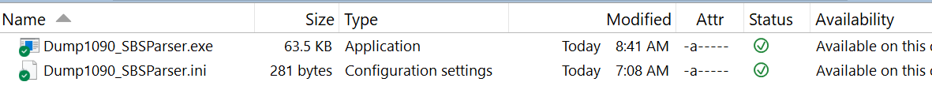
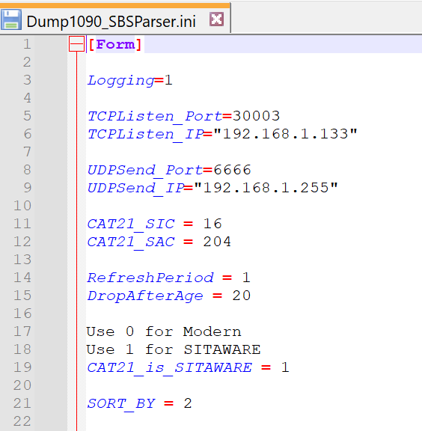
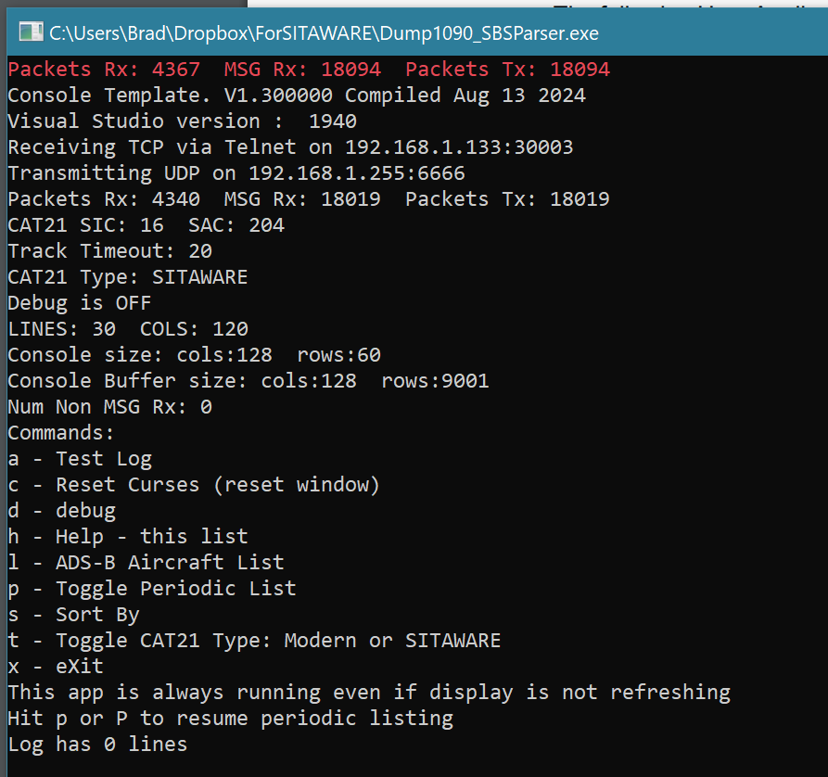
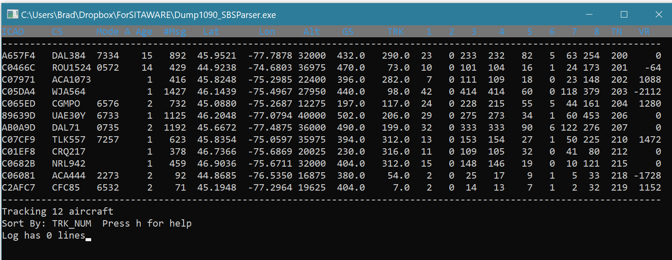

Slide 3
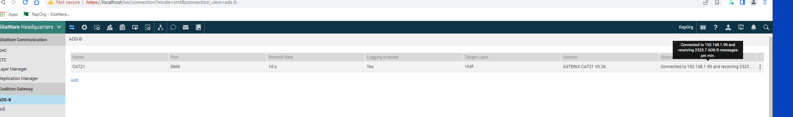
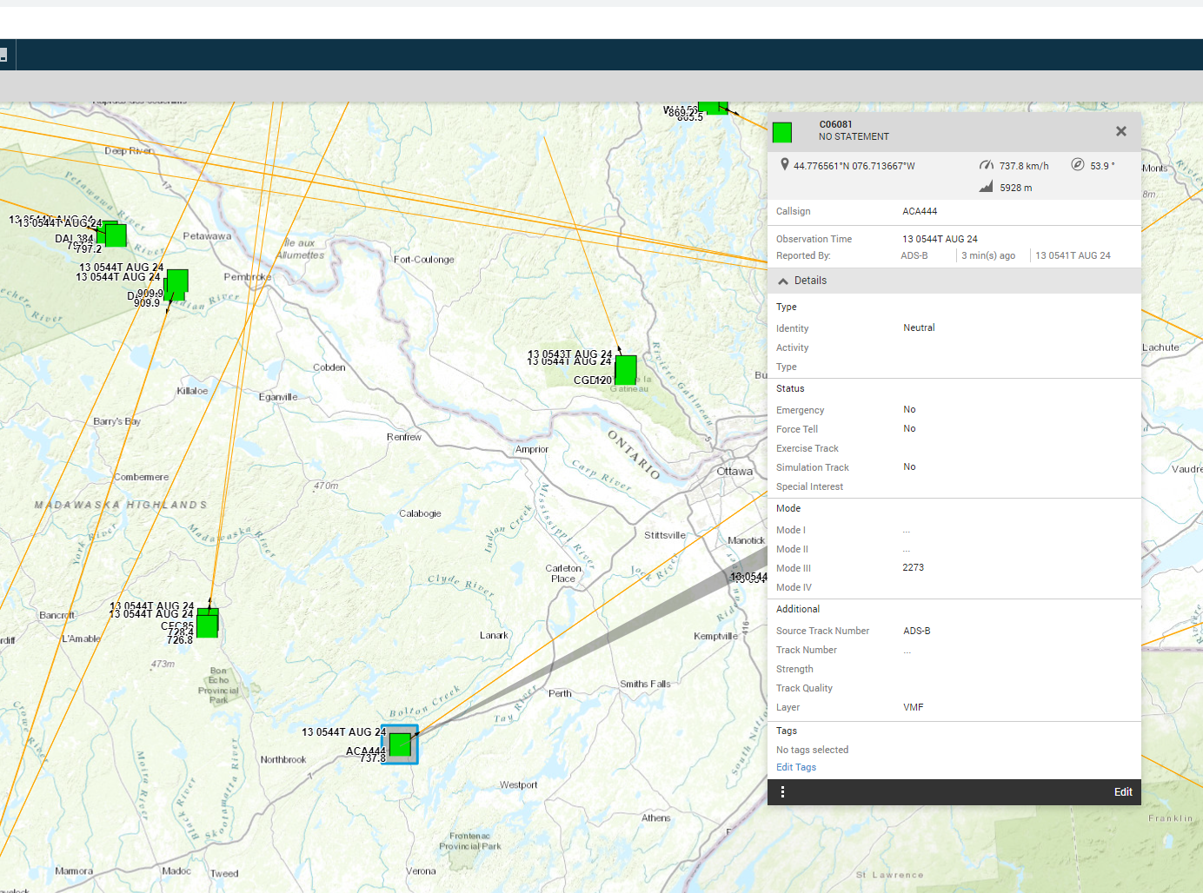
SHQ receiving V0.26 CAT21 DUMP1090_SBS_Parser

Slide 4
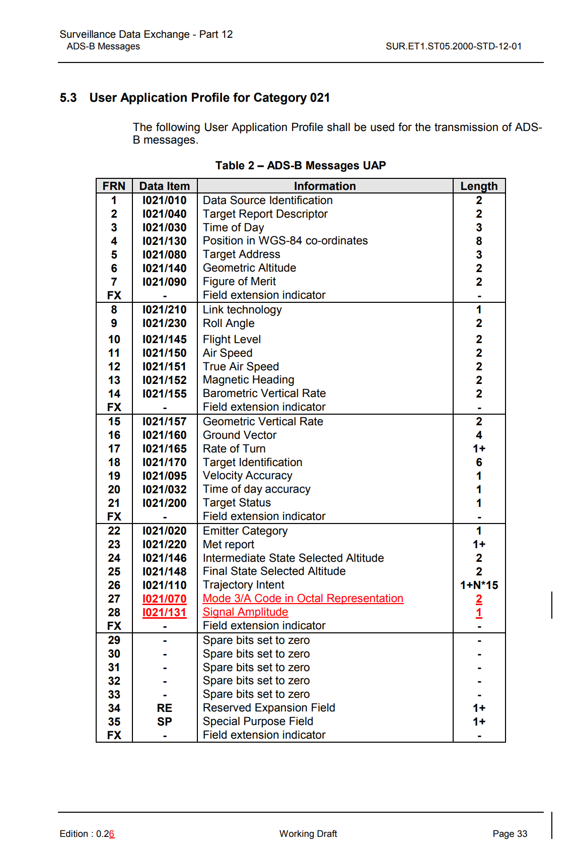
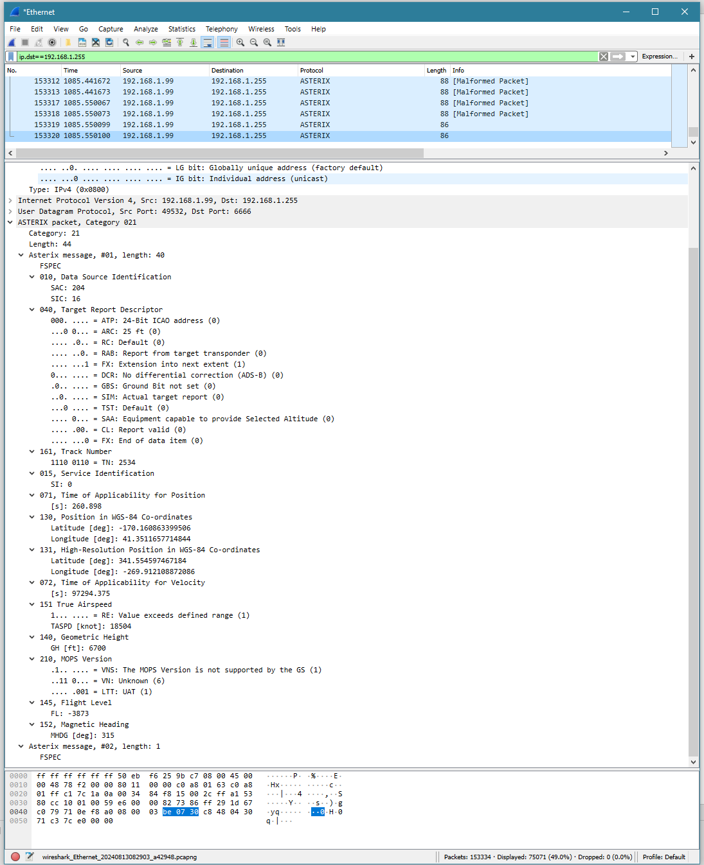
Wireshark dissector does not work cleanly with CAT21 V 0.26
It expects V2.X

Slide 5
V2.6 Decode
Does not work with SITAWARE
Works with CSI

Slide 6
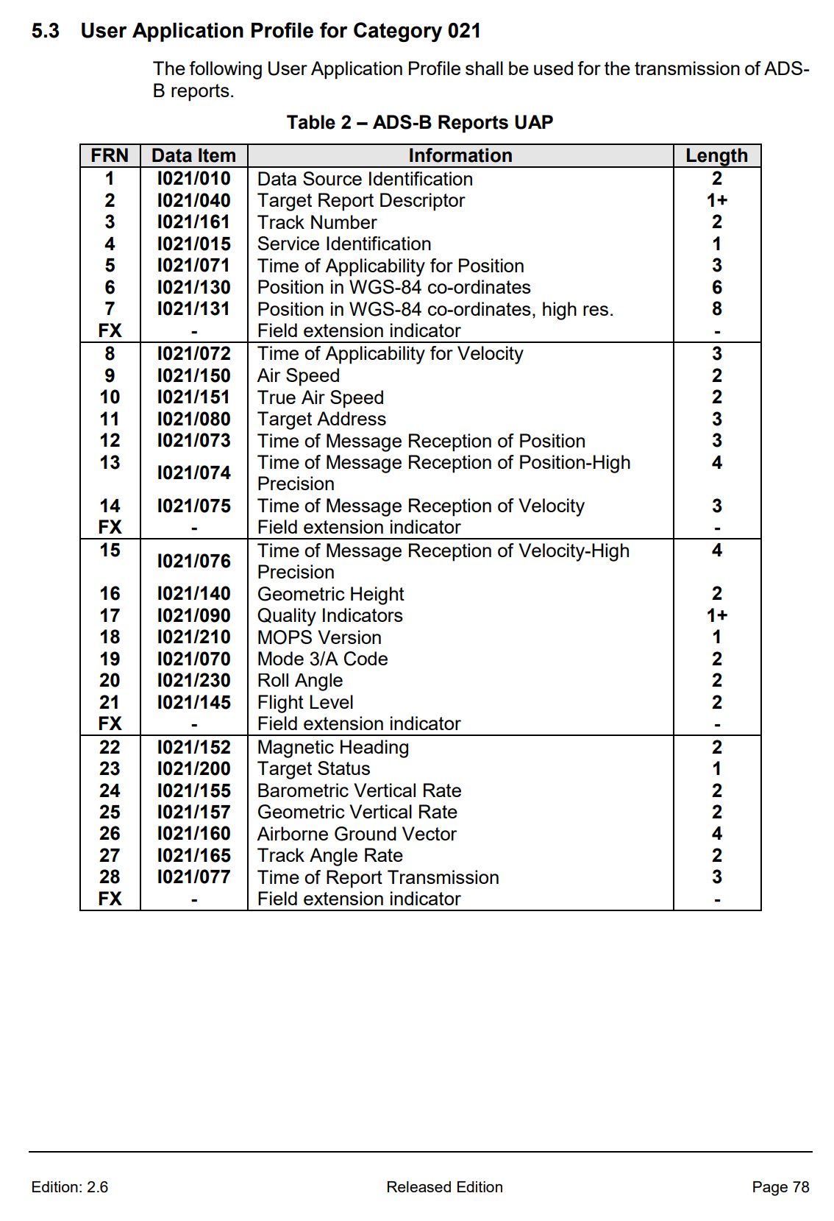
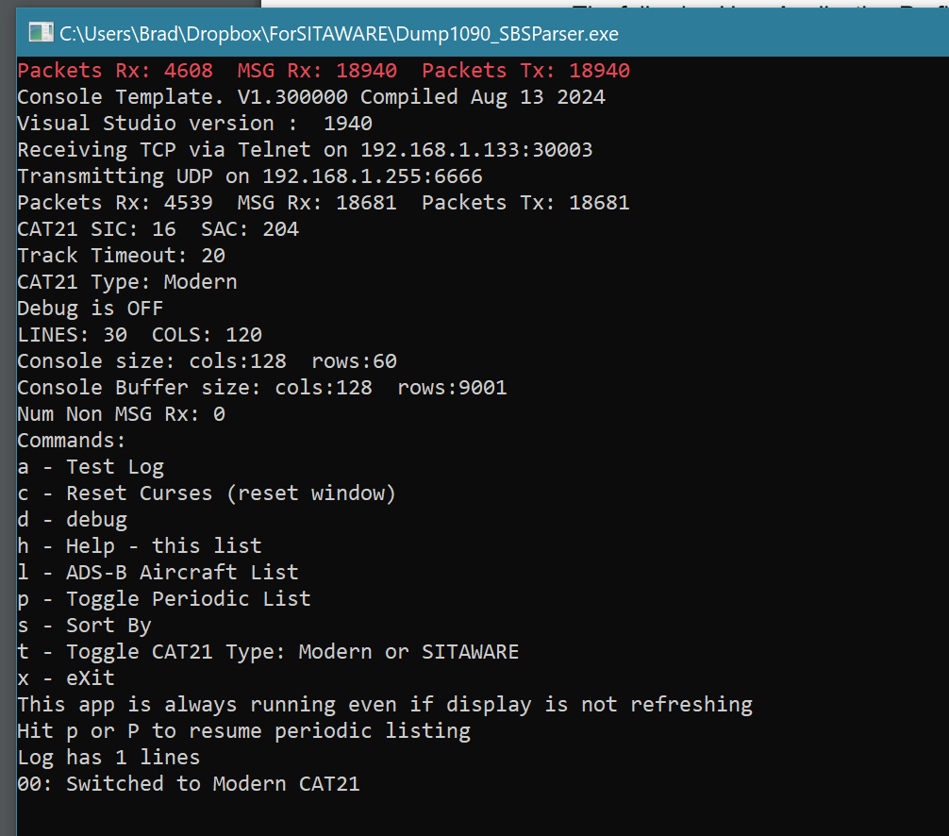
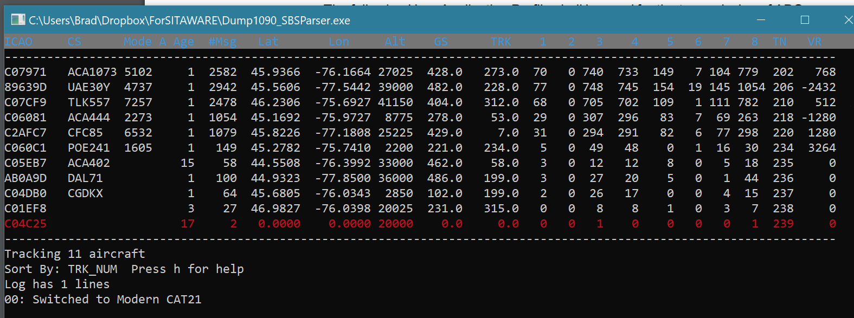

Slide 7
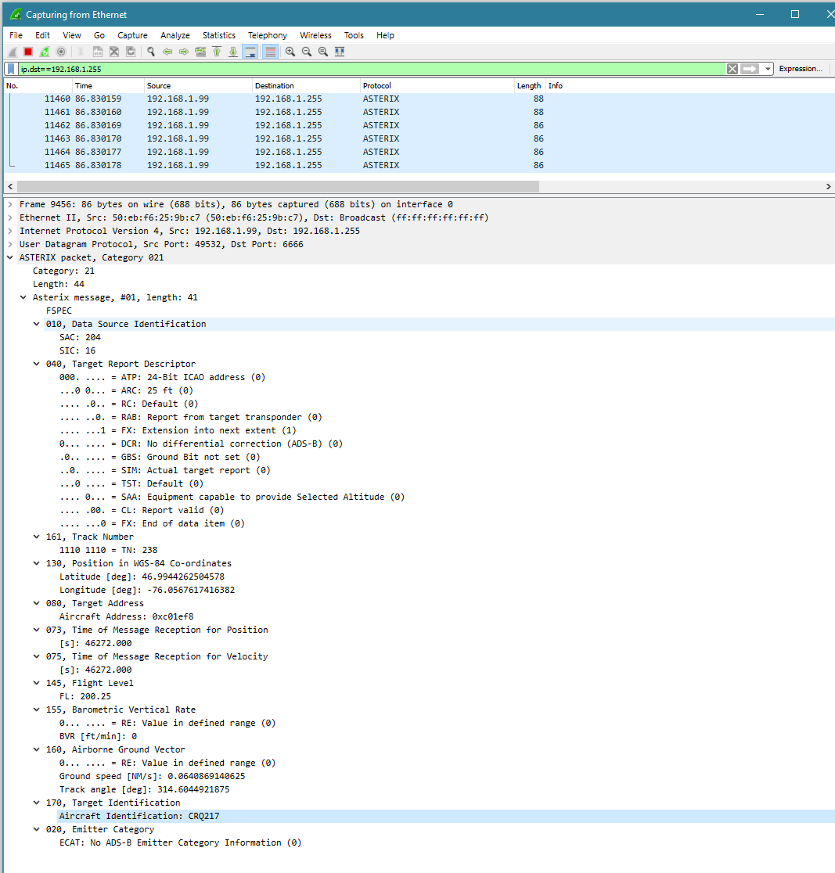
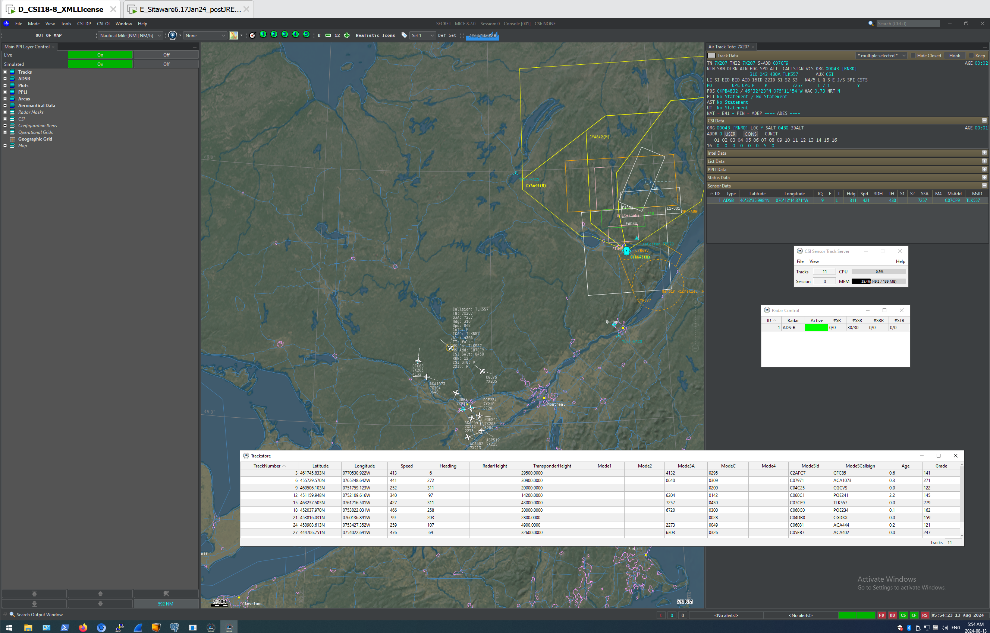
Wireshark dissector does work cleanly with CAT21 V 2.3 and above. This is CAT 21 V2.6 format
CSI/CSTS working with CAT21 V2.6

Slide 8
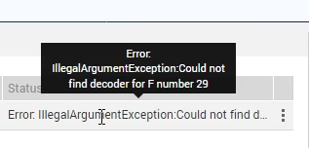
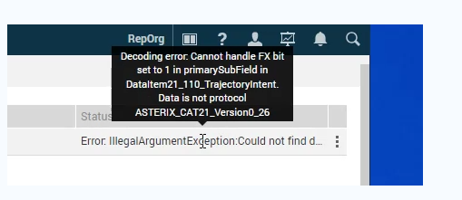
Example Errors from SITAWARE when CAT21 version is 2.6

